Slide 1
INST 414: Data Science Techniques Lecture 2 Probability Basics

Slide 2
Announcements
First Quiz next week
Will be posted Monday morning
You will have 15 minutes to complete it
3 questions
Topics: Basic Probability + Scoring a defendant on a risk assessment
Please fill out office hours survey

Slide 3
Probability Basics

Slide 4
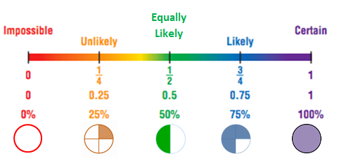
What is Probability?
Probability measures the likelihood of an event occurring
Range: 0 (impossible) to 1 (certain)
Formula:
P(Event) = Number of favorable outcomes / Number of all outcomes
Source

Slide 5
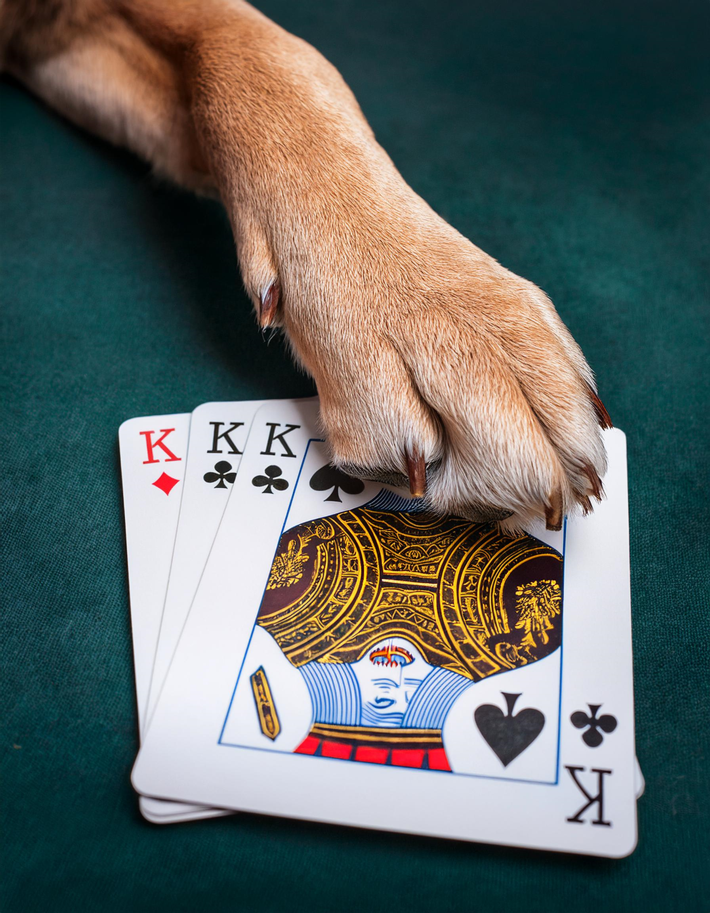
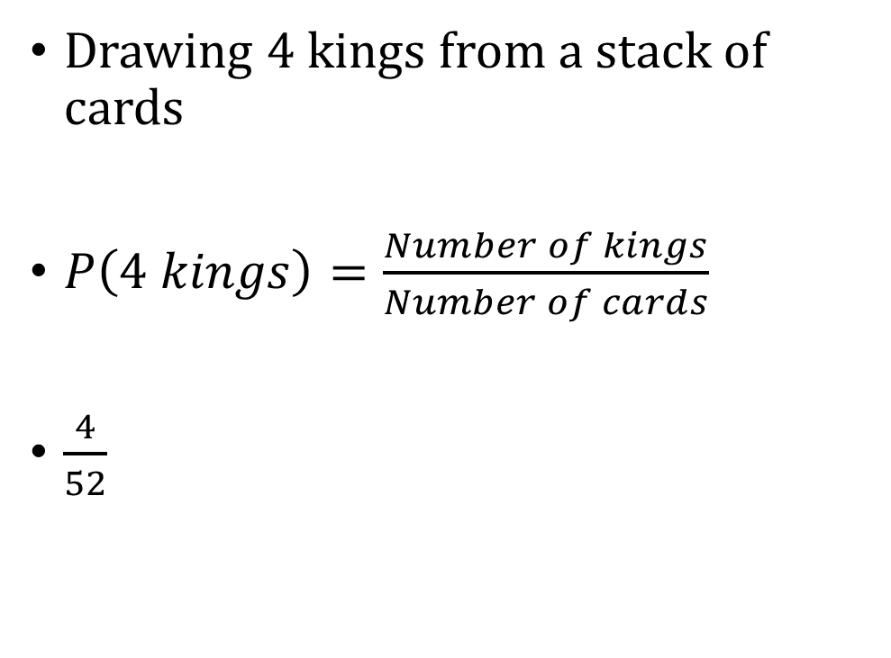
Example
Drawing 4 kings from a stack of cards
$P\left(4 kings\right)=\frac{Number of kings}{Number of cards}$
$\frac{4}{52}$

Slide 6
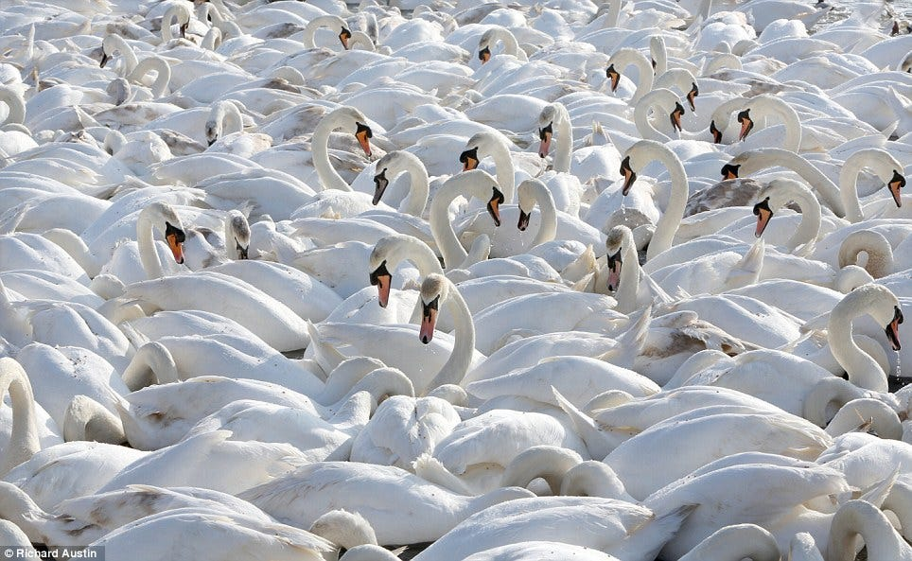
Induction
Is the answer always going to be 4/52?
How do we know?

Slide 7
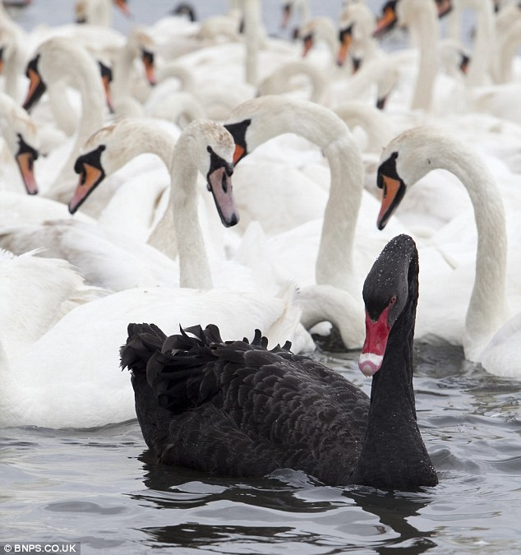
Induction
Is the answer always going to be 4/52?
How do we know?
Via induction:
Generating principles from data

Slide 8
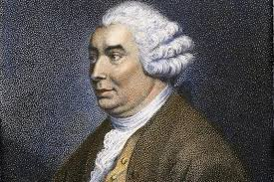
The Problem of Induction
A Treatise of Human Nature, writing "there can be no demonstrative arguments to prove, that those instances, of which we have had no experience, resemble those, of which we have had experience.“ (1739)

Slide 9
The Problem of Induction
How do you justify using induction?
View: It does not follow from rational logic
Modern science is in part, faith-based

Slide 10
The Problem of David Hume
Also David Hume:
“I am apt to suspect the Negroes [sic] to be naturally inferior to the whites.”

Slide 11
Probability and Induction
We are going to use past data to induct future patterns:
In the past, 25% of people with prior FTA also FTA’ed in the next year.
Of new people who have prior FTA, 25% will also FTA in the future
We are going to use induction to generate probabilities.

Slide 12
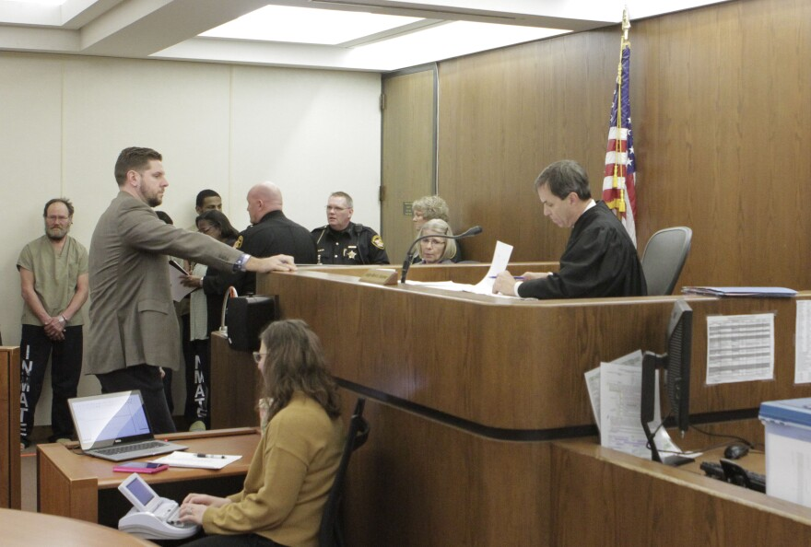
Probability in the Real World
Context: Bail/Pretrial
When a person gets arrested, they go in front of a judge who decides to detain or release
Decision is based on flight or public safety risk:
Will the defendant be re-arrested during this pretrial period?
Will the defendant not show up at a future court date?
Both of these questions are essentially predictions

Slide 13
How Do We Make a Prediction?
Imagine you are a judge. What pieces of information would you like for making a prediction about whether the defendant in front of you will show up at their next court date?

Slide 14
How Do We Make a Prediction?
In your jurisdiction, out of 24,293 defendants, there were 3,595 who FTA’ed at some point during their pretrial period (missed their court date) savageace23

Slide 15
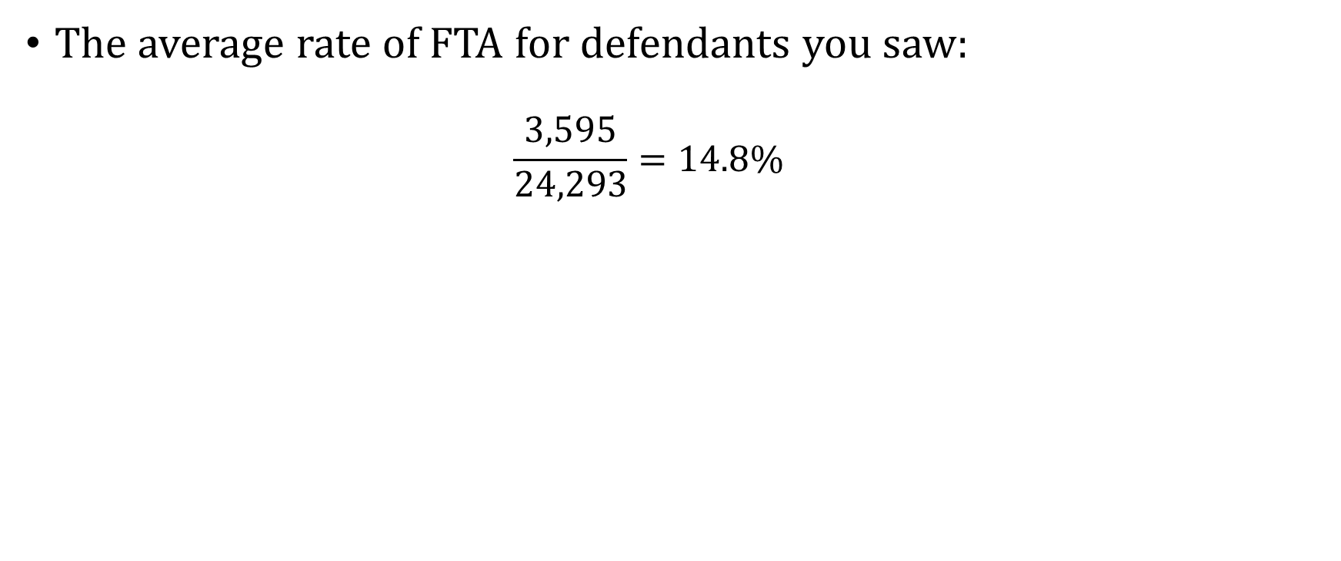
The Overall FTA Rate
The average rate of FTA for defendants you saw:
$$\frac{3,595}{24,293}=14.8\%$$

Slide 16
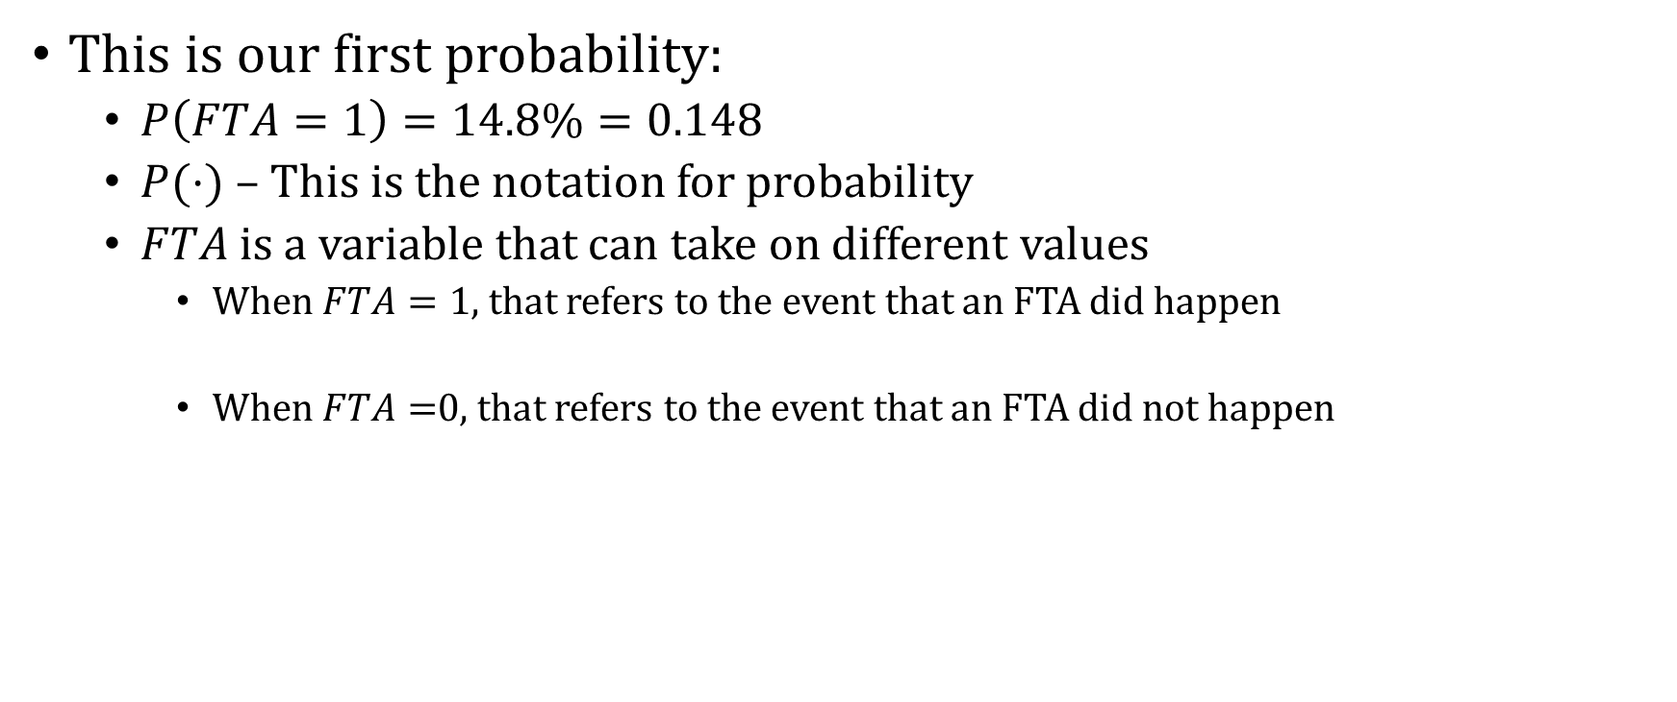
The Overall FTA Rate
This is our first probability:
$P\left(FTA=1\right)=14.8\%=0.148$
$P(⋅)$ – This is the notation for probability
$FTA$ is a variable that can take on different values
When $FTA=1$, that refers to the event that an FTA did happen
When $FTA=$0, that refers to the event that an FTA did not happen

Slide 17
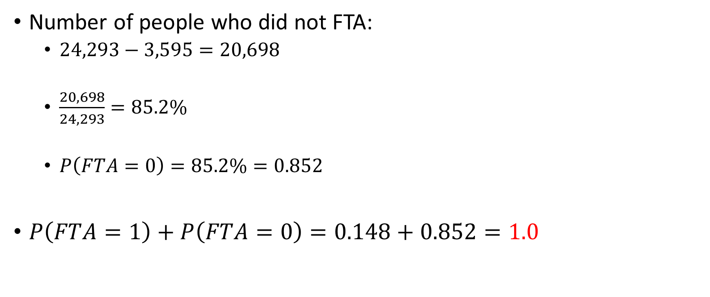
What Is the Chance of No FTA?
Number of people who did not FTA:
$24,293−3,595=20,698$
$\frac{20,698}{24,293}=85.2\%$
$P\left(FTA=0\right)=85.2\%=0.852$
$P\left(FTA=1\right)+P\left(FTA=0\right)=0.148+0.852=1.0$

Slide 18
Rules of Probability
Rule: The sum of the probabilities of “mutually exclusive” outcomes equals one
Mutually exclusive means that the events can’t happen at the same time:
A person can’t both FTA and not FTA for a court appearance

Slide 19
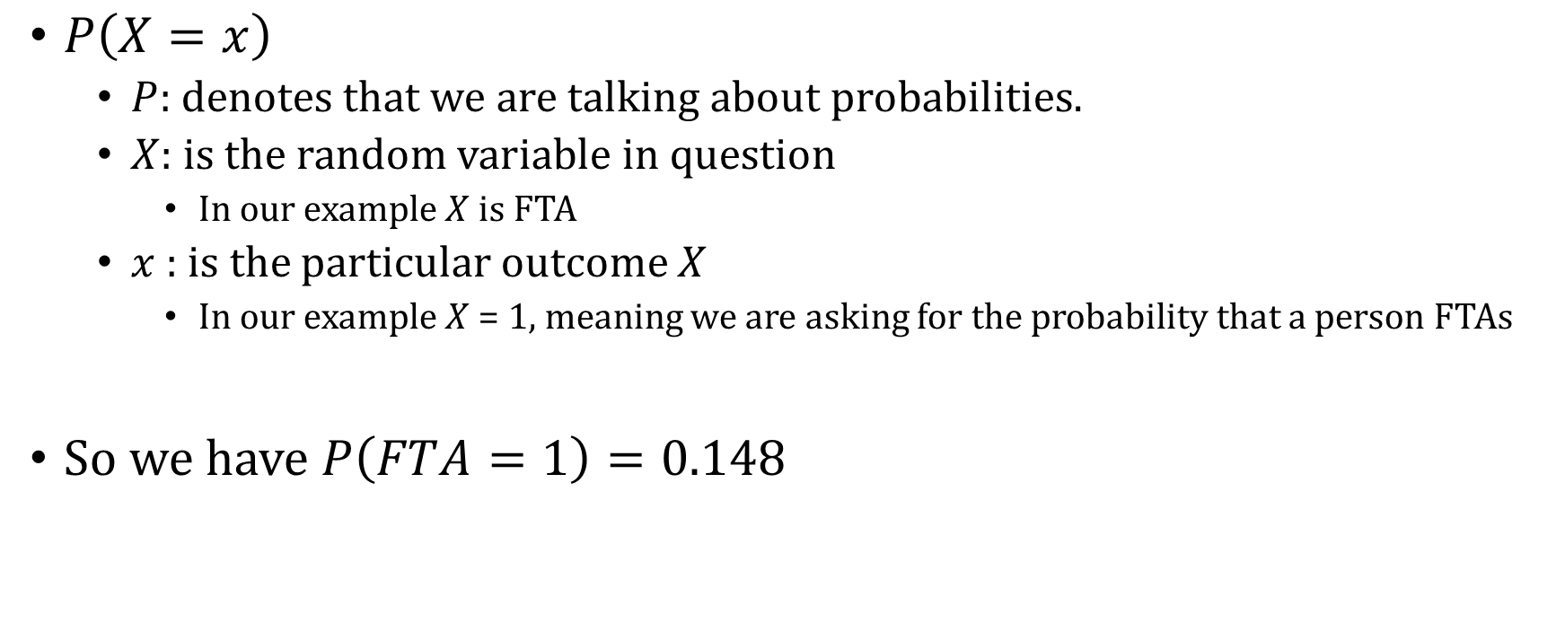
Notation We Will Use
$P\left(X=x\right)$
$P:$ denotes that we are talking about probabilities.
$X:$ is the random variable in question
In our example $X$ is FTA
$x$ : is the particular outcome $X$
In our example $X$ = 1, meaning we are asking for the probability that a person FTAs
So we have $P\left(FTA=1\right)=0.148$

Slide 20
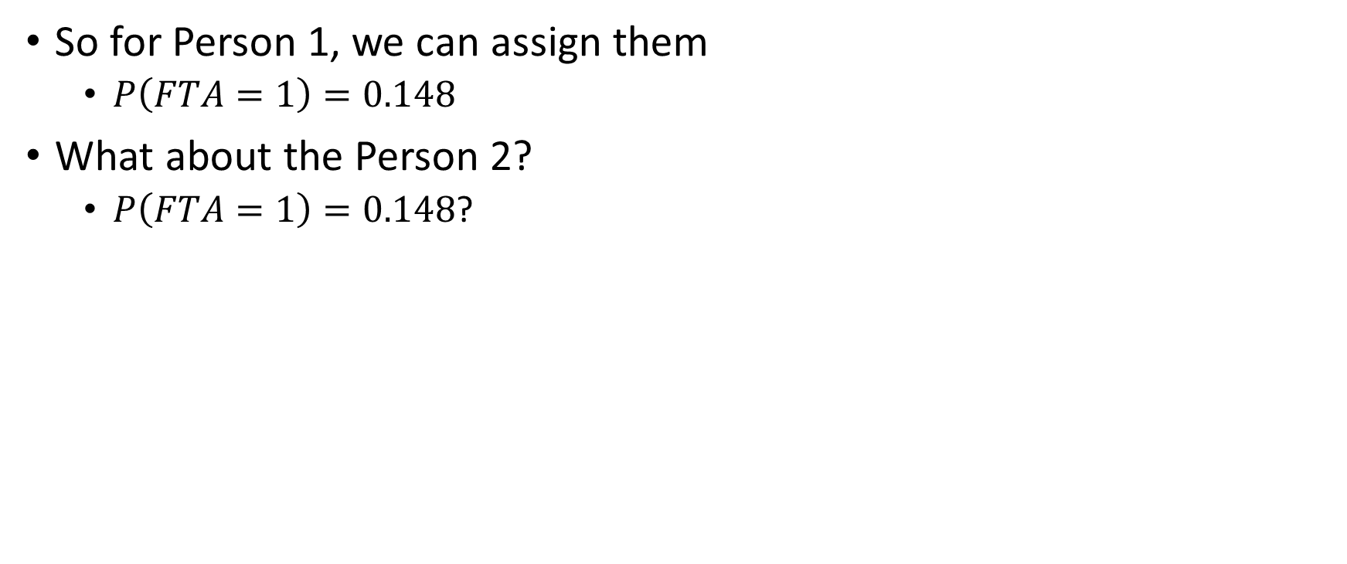
What Is Our Prediction?
So for Person 1, we can assign them
$P\left(FTA=1\right)=0.148$
What about the Person 2?
$P\left(FTA=1\right)=0.148$?

Slide 21
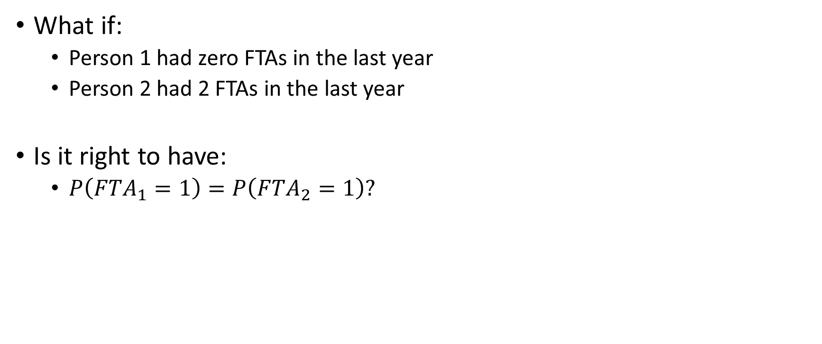
Predictors
What if:
Person 1 had zero FTAs in the last year
Person 2 had 2 FTAs in the last year
Is it right to have:
$P\left(FTA_{1}=1\right)=P\left(FTA_{2}=1\right)?$

Slide 22
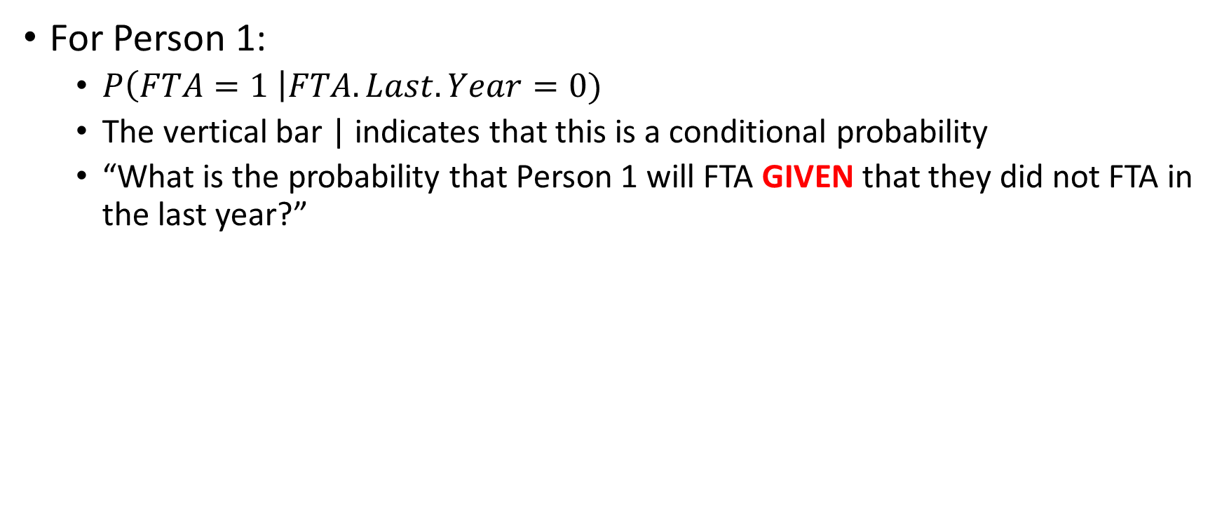
Conditional Probabilities
For Person 1:
$P\left(FTA=1 \right|FTA.Last.Year=0)$
The vertical bar | indicates that this is a conditional probability
“What is the probability that Person 1 will FTA GIVEN that they did not FTA in the last year?”

Slide 23
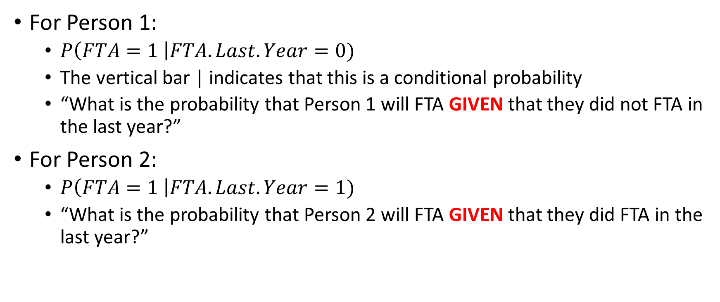
Conditional Probabilities
For Person 1:
$P\left(FTA=1 \right|FTA.Last.Year=0)$
The vertical bar | indicates that this is a conditional probability
“What is the probability that Person 1 will FTA GIVEN that they did not FTA in the last year?”
For Person 2:
$P\left(FTA=1 \right|FTA.Last.Year=1)$
“What is the probability that Person 2 will FTA GIVEN that they did FTA in the last year?”

Slide 24
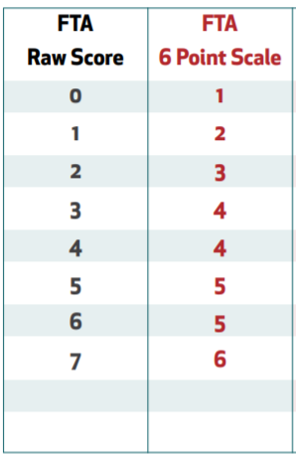
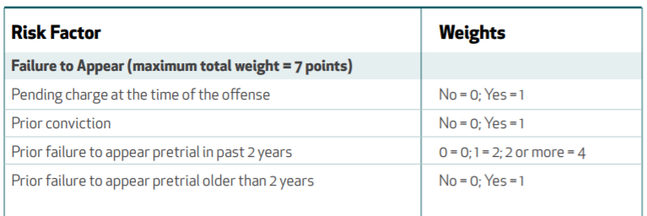
Scoring
Defendant arrested on a harassment charge
Had one prior violent conviction
Had one failure to appear last year
Had no pending charges
What is this defendant’s FTA score?
0 + 1 + 2 + 0 = 3

Slide 25
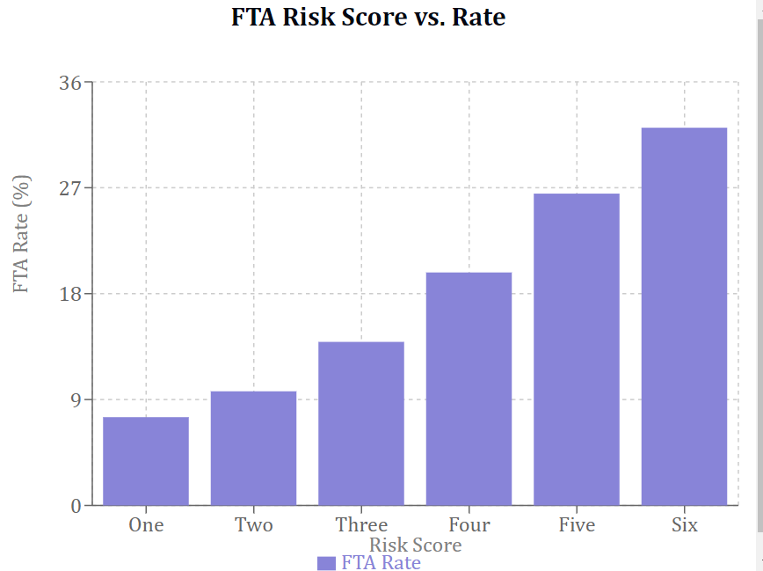
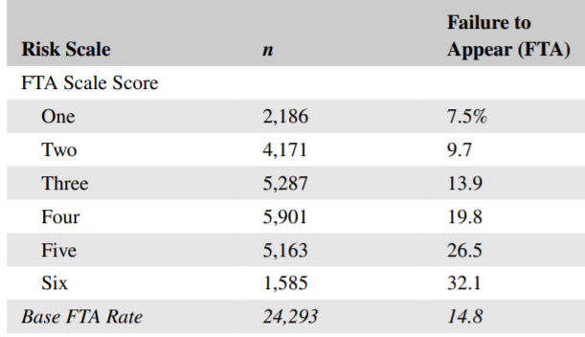
Public Safety Assessment
Source: DeMichele, Matthew, et al. "Public safety assessment: Predictive utility and differential prediction by race in Kentucky." Criminology & Public Policy 19.2 (2020)

Slide 26
Agenda
Random Variables + Events
Joint Distributions
Marginal Distributions
Probability Practice

Slide 27

Random Variables and Events
A random variable – uncertain value (result of a random process)
Example of variables that are not random
Yesterday’s weather
Your weight when you were born
Example of variables that are random
Tomorrow’s weather
Height of child in 5 years

Slide 28
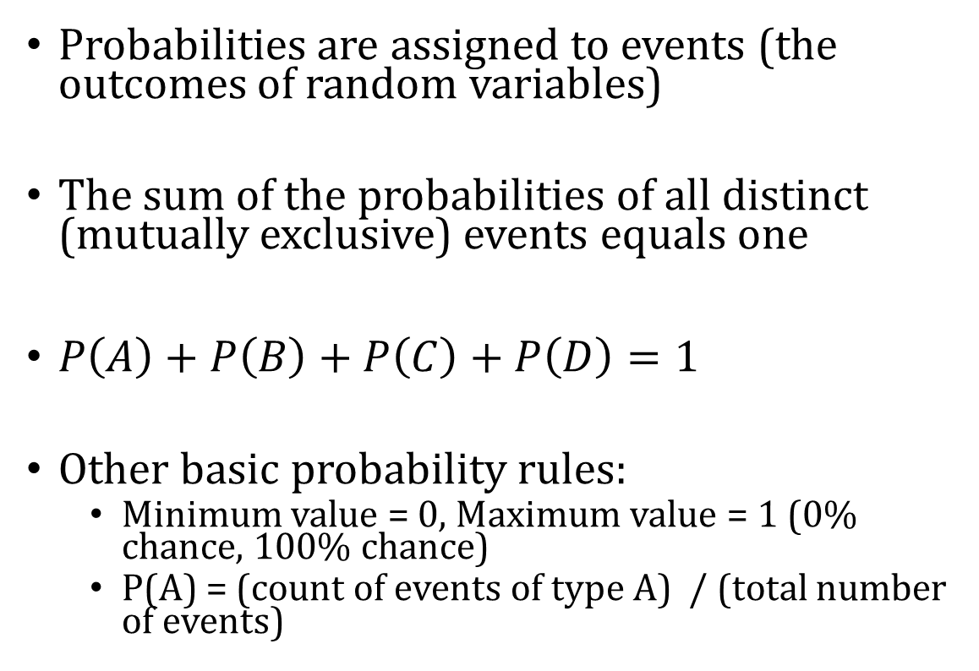
Events
Probabilities are assigned to events (the outcomes of random variables)
The sum of the probabilities of all distinct (mutually exclusive) events equals one
$P\left(A\right)+P\left(B\right)+P\left(C\right)+P\left(D\right)=1$
Other basic probability rules:
Minimum value = 0, Maximum value = 1 (0% chance, 100% chance)
P(A) = (count of events of type A) / (total number of events)
A
B
C
D

Slide 29
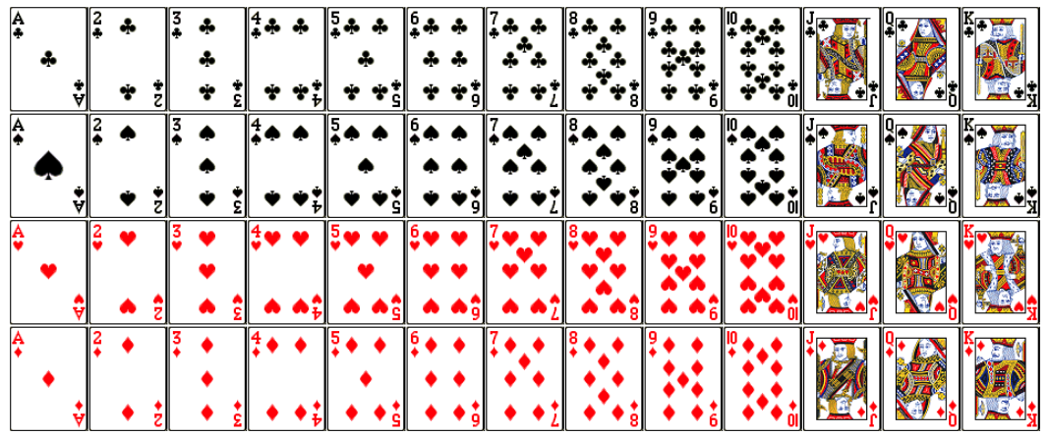
“Event Space”
What are all of the distinct events that could happen when selecting a card from a deck?

Slide 30
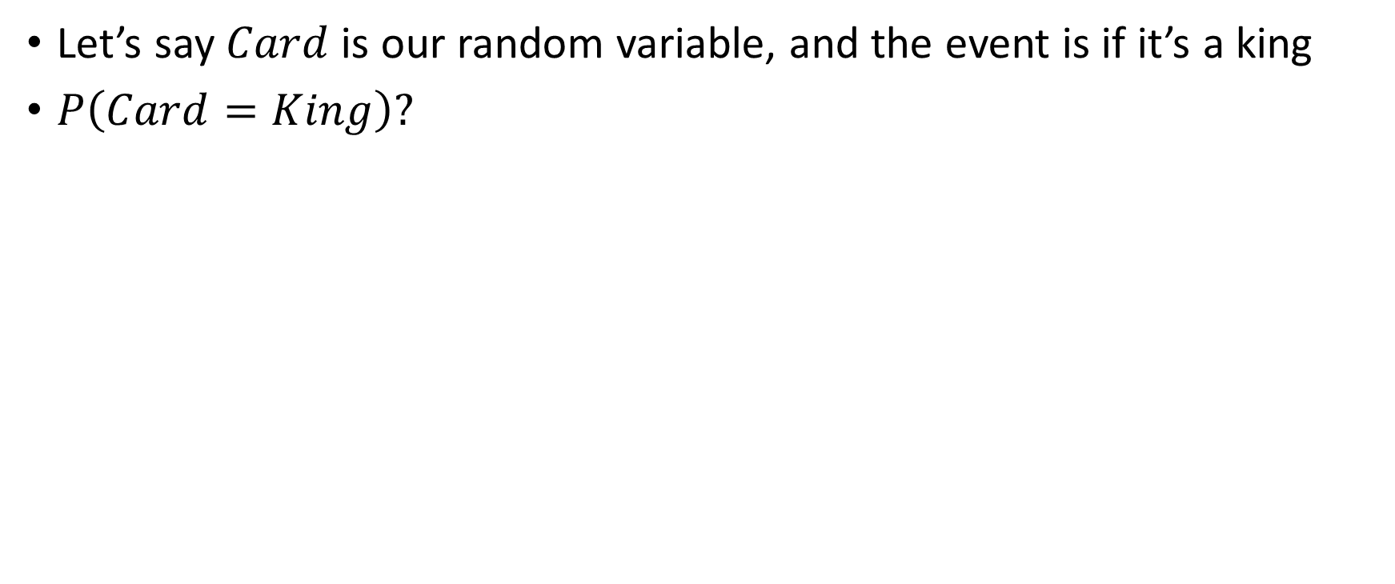
Event Space
Let’s say $Card$ is our random variable, and the event is if it’s a king
$P\left(Card=King\right)?$

Slide 31
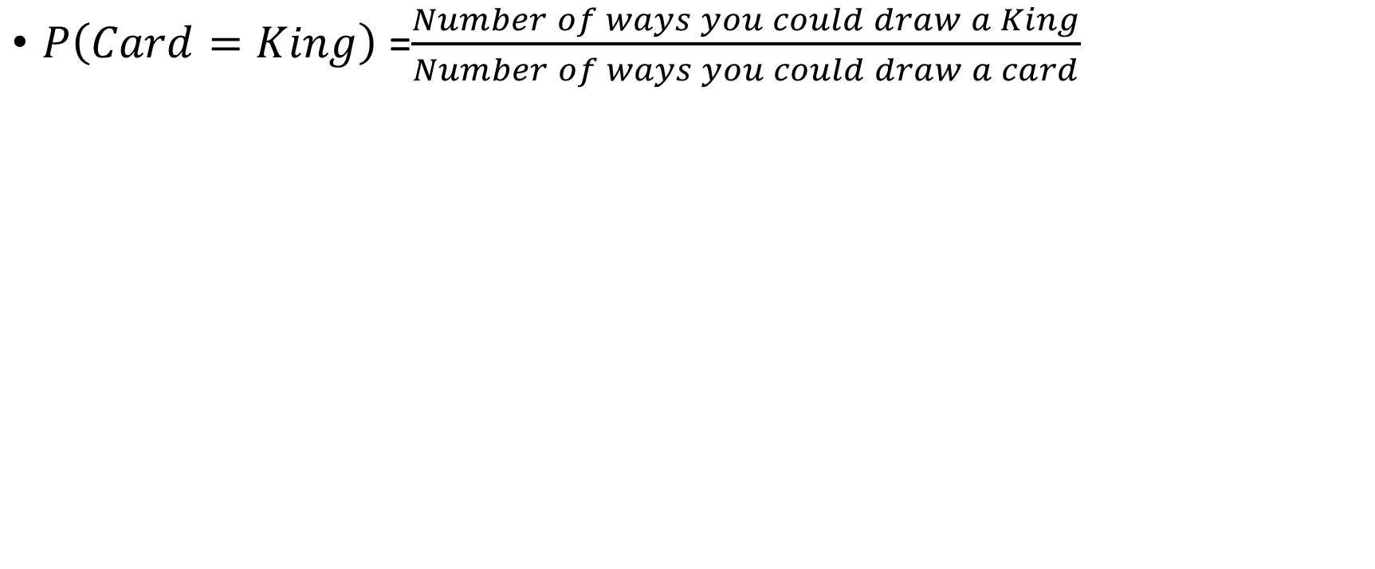
Event Space
$P\left(Card=King\right)$=$\frac{Number of ways you could draw a King}{Number of ways you could draw a card}$

Slide 32
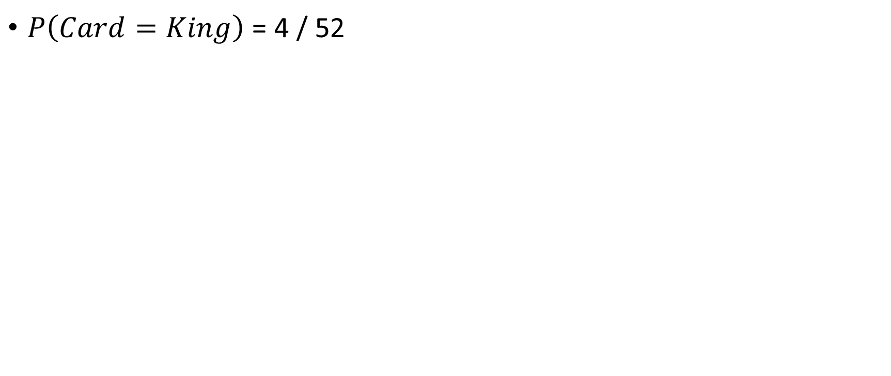
Event Space
$P\left(Card=King\right)$ = 4 / 52

Slide 33
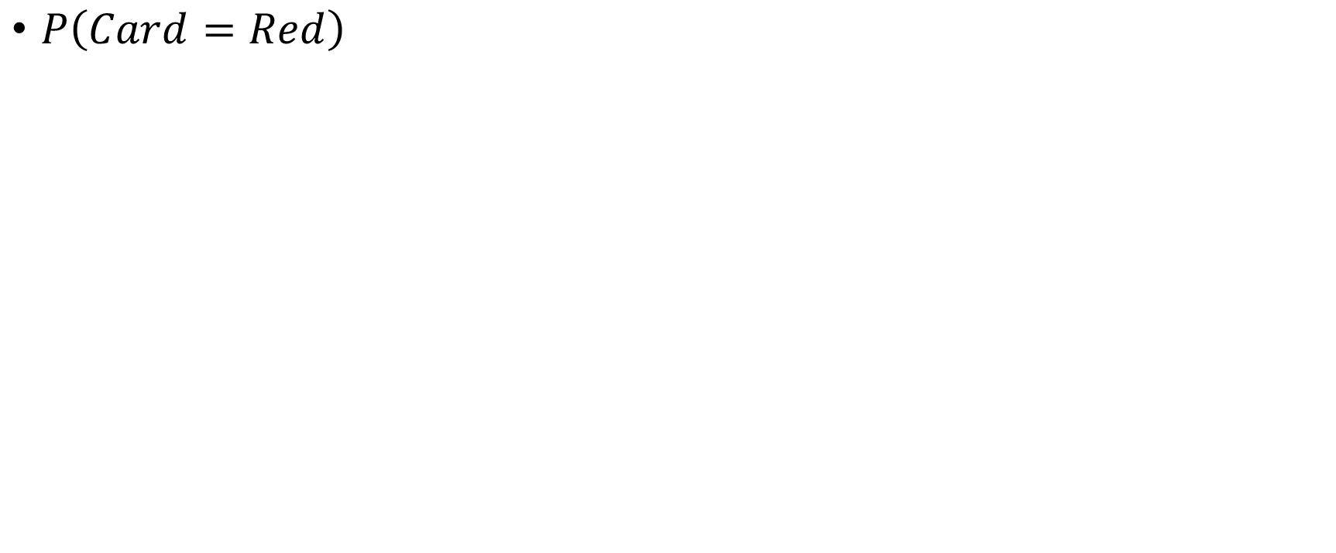
Event Space
$P\left(Card=Red\right)$

Slide 34
Event Space
$P\left(Card=Red\right)$

Slide 35
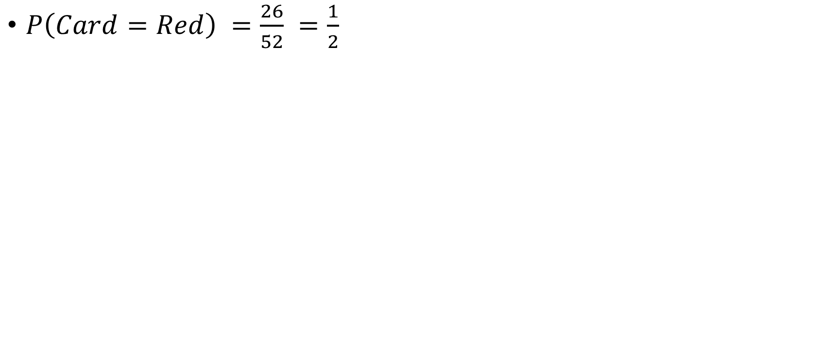
Event Space
$P\left(Card=Red\right) =\frac{26}{52} =\frac{1}{2}$

Slide 36
Event Space
$P\left(Card=Red\right)$

Slide 37
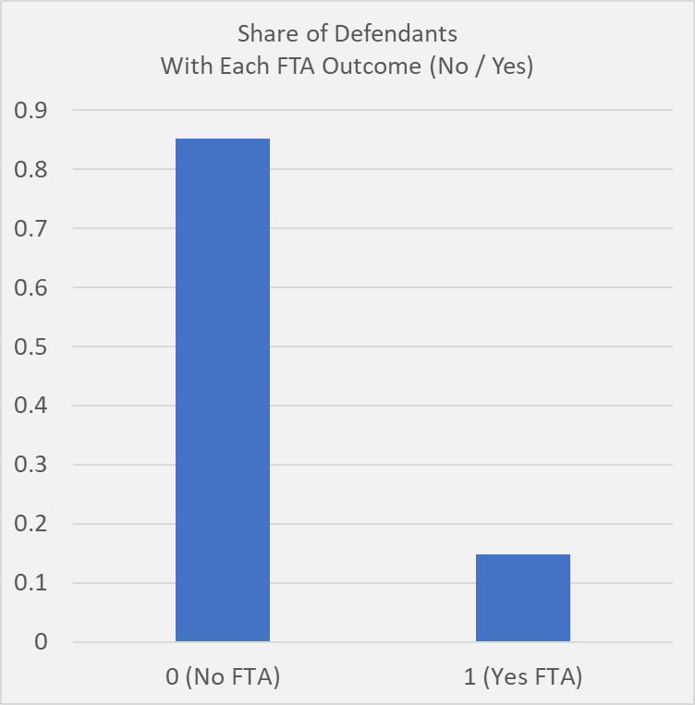
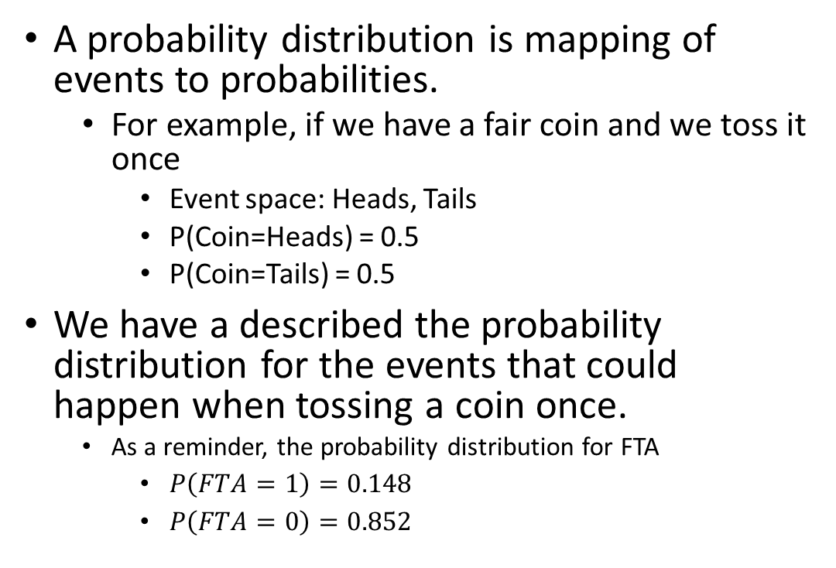
Probability Distributions
A probability distribution is mapping of events to probabilities.
For example, if we have a fair coin and we toss it once
Event space: Heads, Tails
P(Coin=Heads) = 0.5
P(Coin=Tails) = 0.5
We have a described the probability distribution for the events that could happen when tossing a coin once.
As a reminder, the probability distribution for FTA
$P\left(FTA=1\right)=0.148$
$P\left(FTA=0\right)=0.852$

Slide 38
Joint Probability Distributions

Slide 39
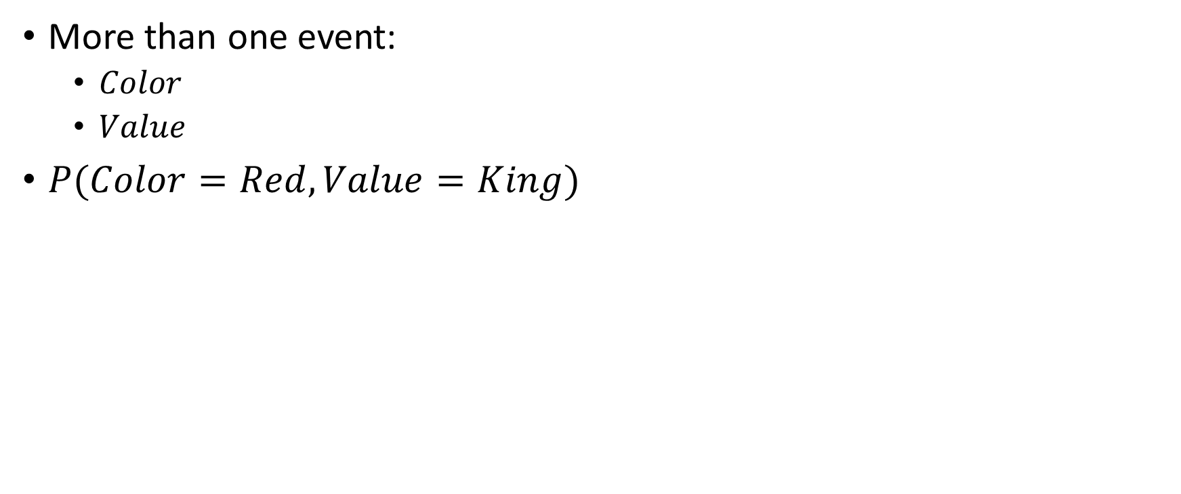
Event Space
More than one event:
$Color$
$Value$
$P(Color=Red, Value=King)$

Slide 40
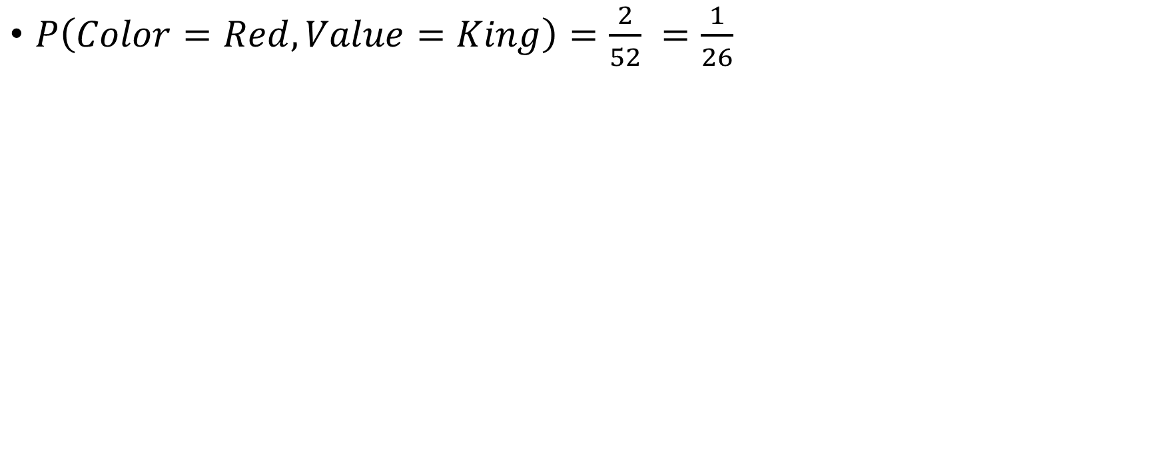
Event Space for Two Random Variables
$P\left(Color=Red, Value=King\right)=\frac{2}{52} =\frac{1}{26}$

Slide 41
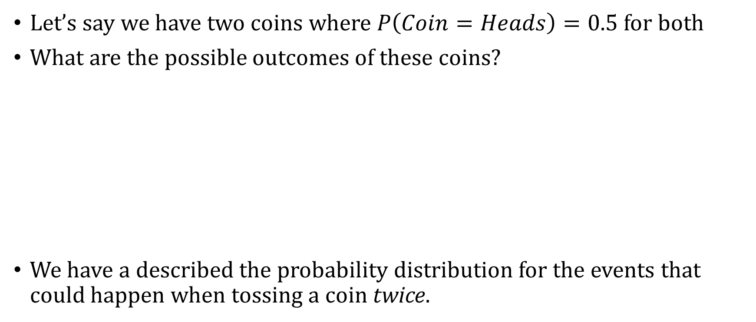
Two Random Variables
Let’s say we have two coins where $P\left(Coin=Heads\right)=0.5$ for both
What are the possible outcomes of these coins?
We have a described the probability distribution for the events that could happen when tossing a coin twice.
Coin 1 | Coin 2 | P(Coin 1=c, Coin 2=c)
Heads | Heads | 0.25
Heads | Tails | 0.25
Tails | Heads | 0.25
Tails | Tails | 0.25

Slide 42
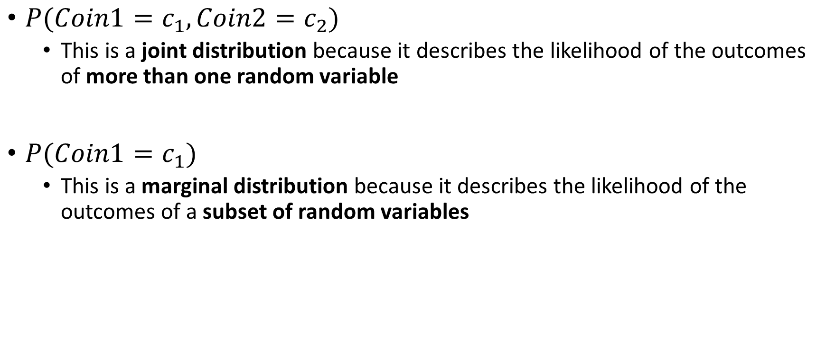
Marginal and Joint Distributions
$P(Coin1=c_{1}, Coin2=c_{2})$
This is a joint distribution because it describes the likelihood of the outcomes of more than one random variable
$P(Coin1=c_{1})$
This is a marginal distribution because it describes the likelihood of the outcomes of a subset of random variables

Slide 43

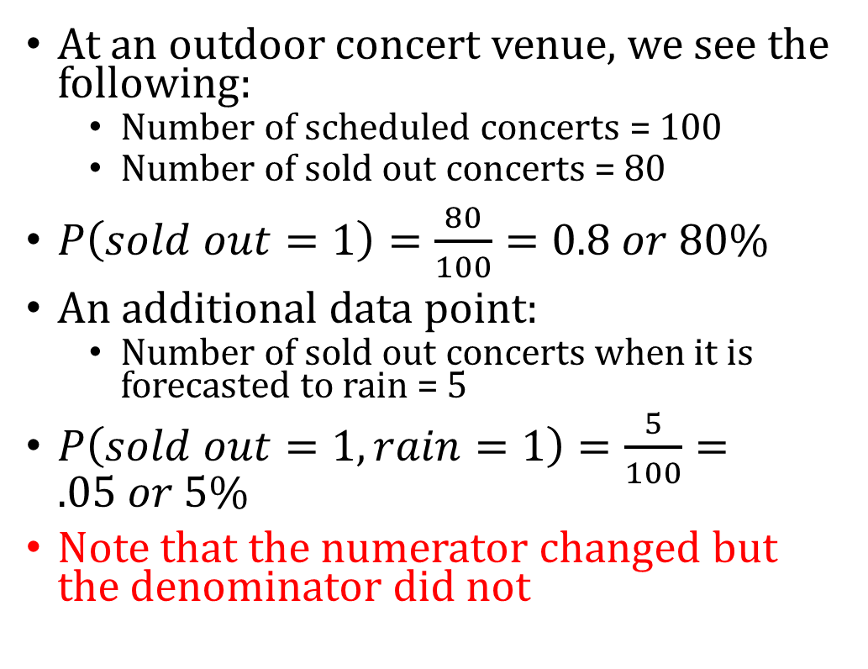
Interpreting Joint Distributions
At an outdoor concert venue, we see the following:
Number of scheduled concerts = 100
Number of sold out concerts = 80
$P\left(sold out=1\right)=\frac{80}{100}=0.8 or 80\%$
An additional data point:
Number of sold out concerts when it is forecasted to rain = 5
$P\left(sold out=1, rain=1\right)=\frac{5}{100}=.05 or 5\%$
Note that the numerator changed but the denominator did not

Slide 44
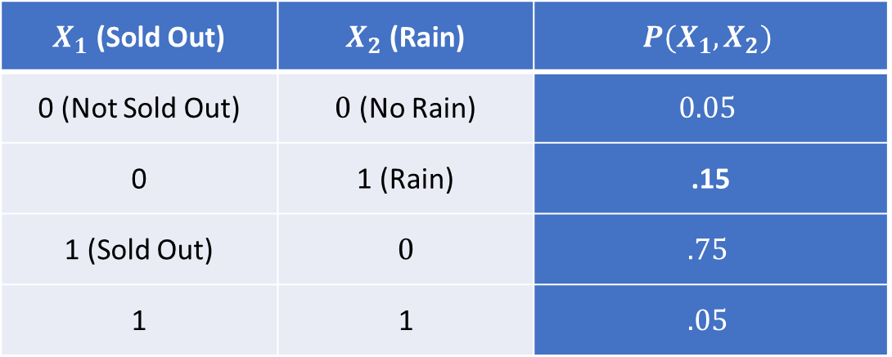
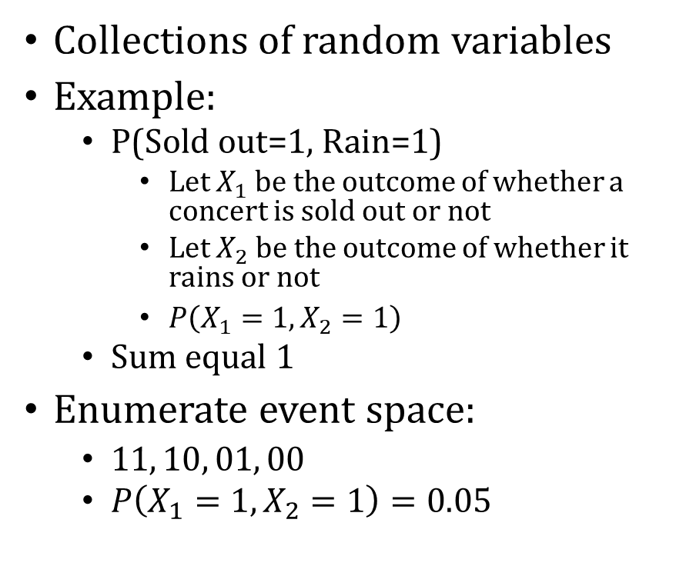
Joint Distribution
Collections of random variables
Example:
P(Sold out=1, Rain=1)
Let $X_{1}$ be the outcome of whether a concert is sold out or not
Let $X_{2}$ be the outcome of whether it rains or not
$P\left(X_{1}=1, X_{2}=1\right)$
Sum equal 1
Enumerate event space:
$11, 10, 01, 00$
$P\left(X_{1}=1, X_{2}=1\right)=0.05$
$X_{1}$ (Sold Out) | $X_{2}$ (Rain) | $$P(X_{1},X_{2})$$
0 (Not Sold Out) | $0$ (No Rain) | $$0.05$$
0 | 1 (Rain) | .15
1 (Sold Out) | $$0$$ | $$.75$$
1 | 1 | $$.05$$

Slide 45
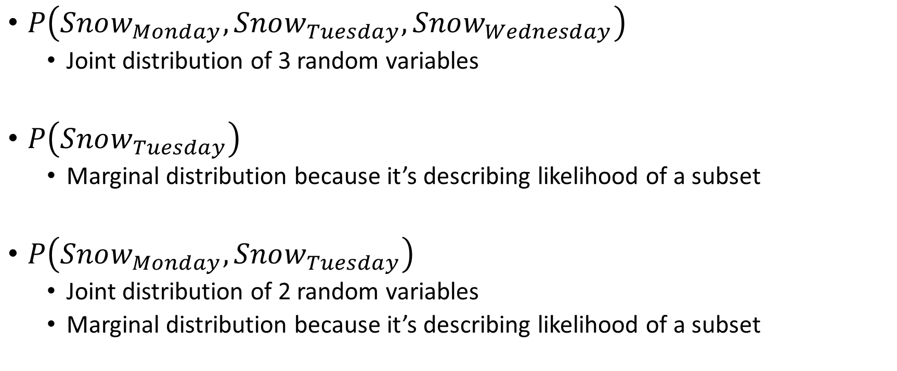
Examples
$P\left(Snow_{Monday},Snow_{Tuesday}, Snow_{Wednesday}\right)$
Joint distribution of 3 random variables
$P\left(Snow_{Tuesday}\right)$
Marginal distribution because it’s describing likelihood of a subset
$P\left(Snow_{Monday}, Snow_{Tuesday}\right)$
Joint distribution of 2 random variables
Marginal distribution because it’s describing likelihood of a subset

Slide 46
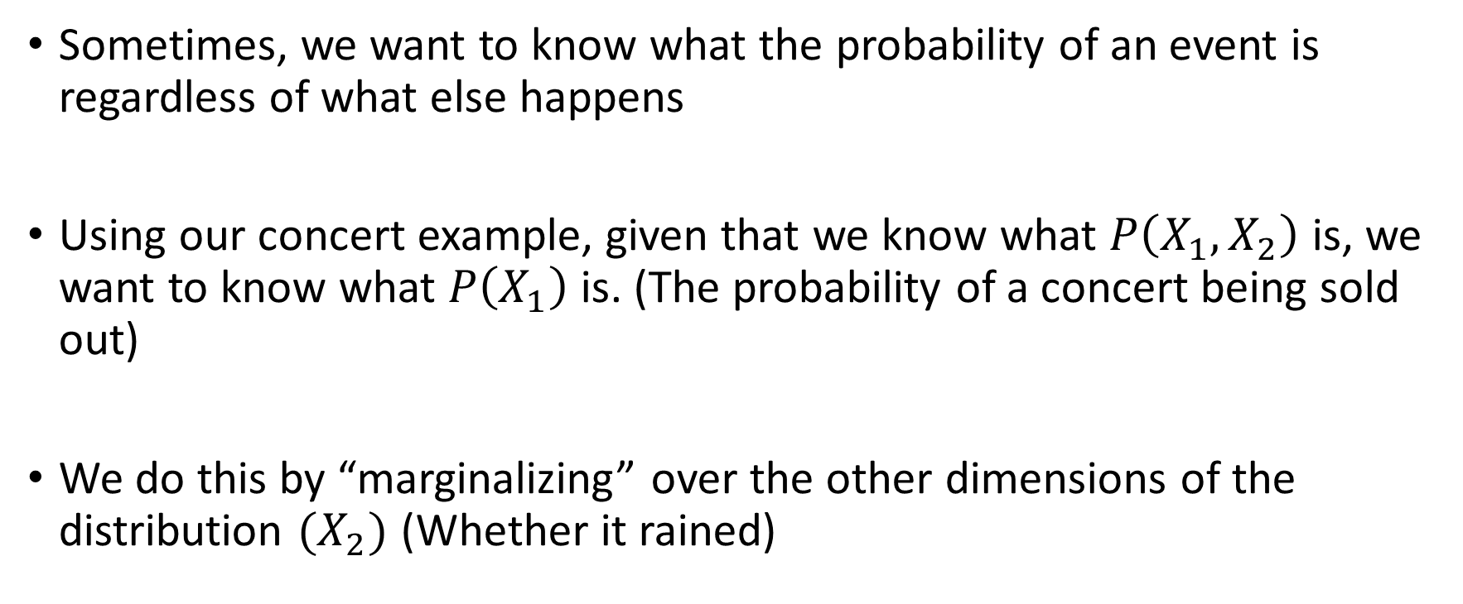
Going from Joint to Marginal Distribution
Sometimes, we want to know what the probability of an event is regardless of what else happens
Using our concert example, given that we know what $P\left(X_{1},X_{2}\right)$ is, we want to know what $P\left(X_{1}\right)$is. (The probability of a concert being sold out)
We do this by “marginalizing” over the other dimensions of the distribution $(X_{2})$ (Whether it rained)

Slide 47
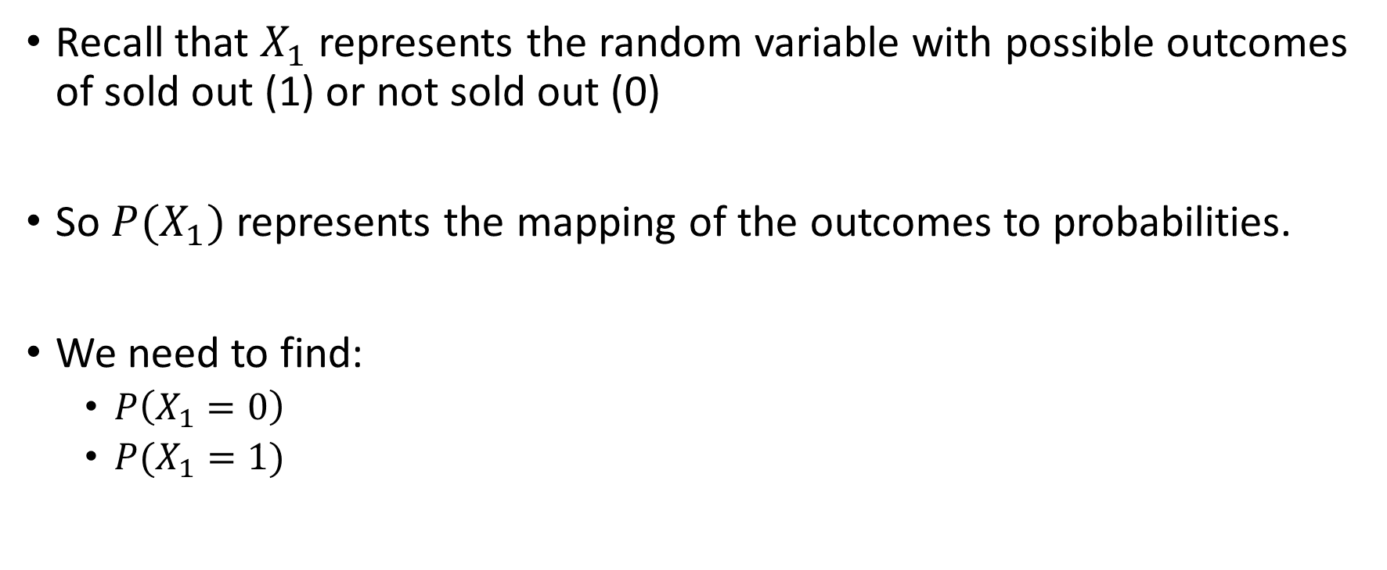

What is $P\left(X_{1}\right)?$
Recall that $X_{1}$ represents the random variable with possible outcomes of sold out (1) or not sold out (0)
So $P(X_{1})$ represents the mapping of the outcomes to probabilities.
We need to find:
$P\left(X_{1}=0\right)$
$P(X_{1}=1)$

Slide 48
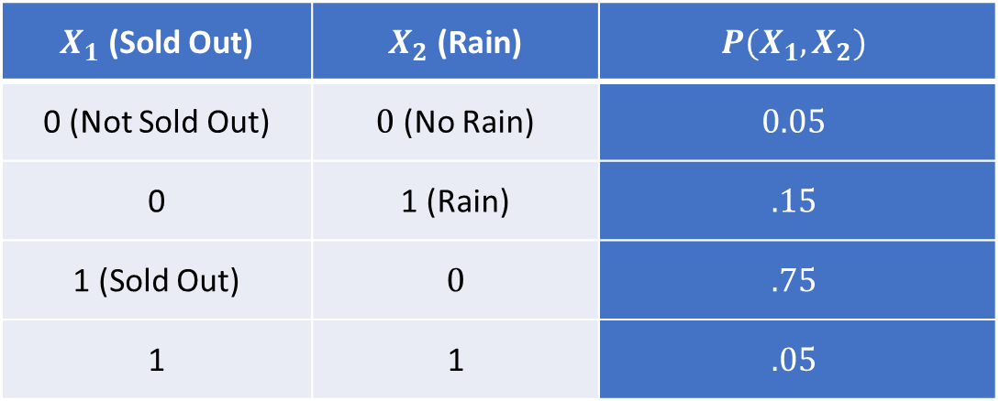
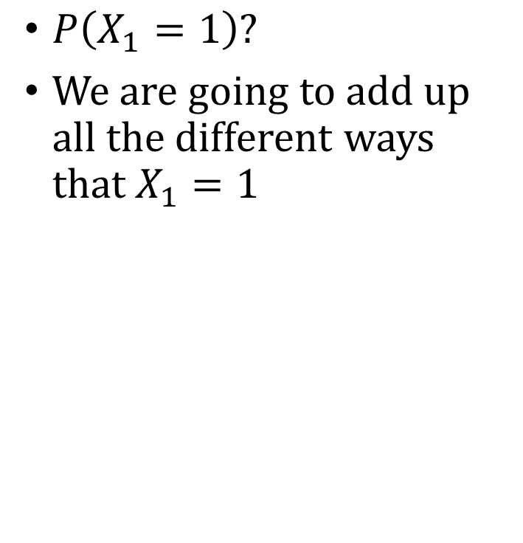
Marginal Distribution Example
$P\left(X_{1}=1\right)?$
We are going to add up all the different ways that $X_{1}=1$
$X_{1}$ (Sold Out) | $X_{2}$ (Rain) | $$P(X_{1},X_{2})$$
0 (Not Sold Out) | $0$ (No Rain) | $$0.05$$
0 | 1 (Rain) | $$.15$$
1 (Sold Out) | $$0$$ | $$.75$$
1 | 1 | $$.05$$

Slide 49

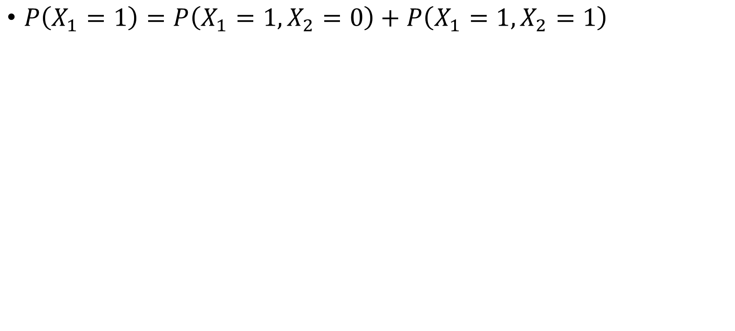
Marginal Distribution Example
$X_{1}$ (Sold Out) | $X_{2}$ (Rain) | $$P(X_{1},X_{2})$$
0 (Not Sold Out) | $0$ (No Rain) | $$0.05$$
0 | 1 (Rain) | $$.15$$
1 (Sold Out) | $$0$$ | $$.75$$
1 | 1 | $$.05$$
$P\left(X_{1}=1\right)=P\left(X_{1}=1, X_{2}=0\right)+P\left(X_{1}=1, X_{2}=1\right)$

Slide 50
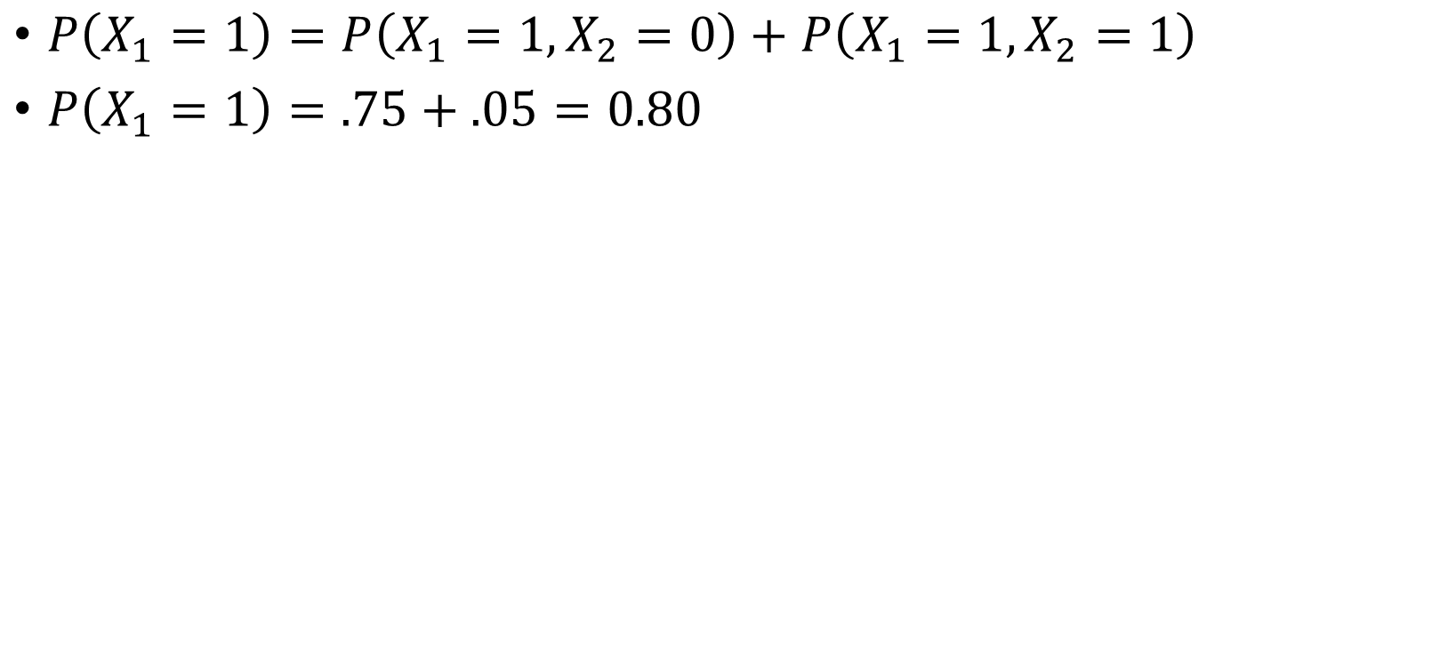
Marginal Distribution Example
$X_{1}$ (Sold Out) | $X_{2}$ (Rain) | $$P(X_{1},X_{2})$$
0 (Not Sold Out) | $0$ (No Rain) | $$0.05$$
0 | 1 (Rain) | $$.15$$
1 (Sold Out) | $$0$$ | $$.75$$
1 | 1 | $$.05$$
$P\left(X_{1}=1\right)=P\left(X_{1}=1, X_{2}=0\right)+P\left(X_{1}=1, X_{2}=1\right)$
$P\left(X_{1}=1\right)=.75+.05=0.80$

Slide 51
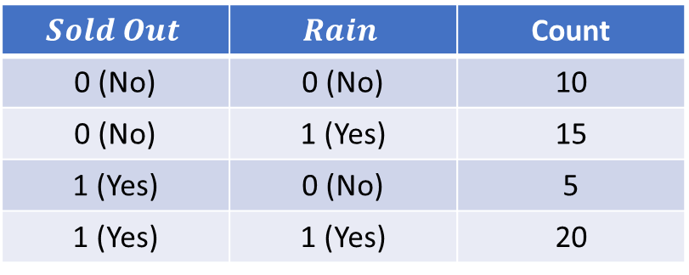
What Are We Doing When We Marginalize?
$$Sold Out$$ | $$Rain$$ | Count
0 (No) | 0 (No) | 10
0 (No) | 1 (Yes) | 15
1 (Yes) | 0 (No) | 5
1 (Yes) | 1 (Yes) | 20
In the last 50 weeks:

Slide 52
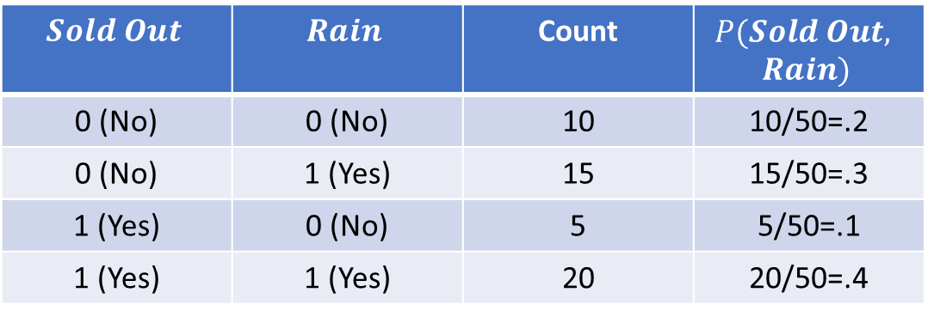
What Are We Doing When We Marginalize?
$$Sold Out$$ | $$Rain$$ | Count | $$P(Sold Out,$$ $$Rain)$$
0 (No) | 0 (No) | 10 | 10/50=.2
0 (No) | 1 (Yes) | 15 | 15/50=.3
1 (Yes) | 0 (No) | 5 | 5/50=.1
1 (Yes) | 1 (Yes) | 20 | 20/50=.4
In the last 50 weeks:

Slide 53
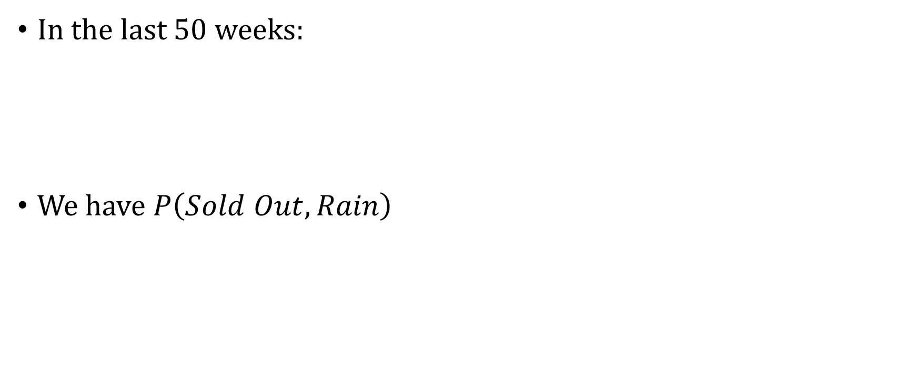
What Are We Doing When We Marginalize?
$$Sold Out$$ | $$Rain$$ | Count | $$P(Sold Out,$$ $$Rain)$$
0 (No) | 0 (No) | 10 | 10/50=.2
0 (No) | 1 (Yes) | 15 | 15/50=.3
1 (Yes) | 0 (No) | 5 | 5/50=.1
1 (Yes) | 1 (Yes) | 20 | 20/50=.4
In the last 50 weeks:
We have $P\left(Sold Out,Rain\right)$

Slide 54
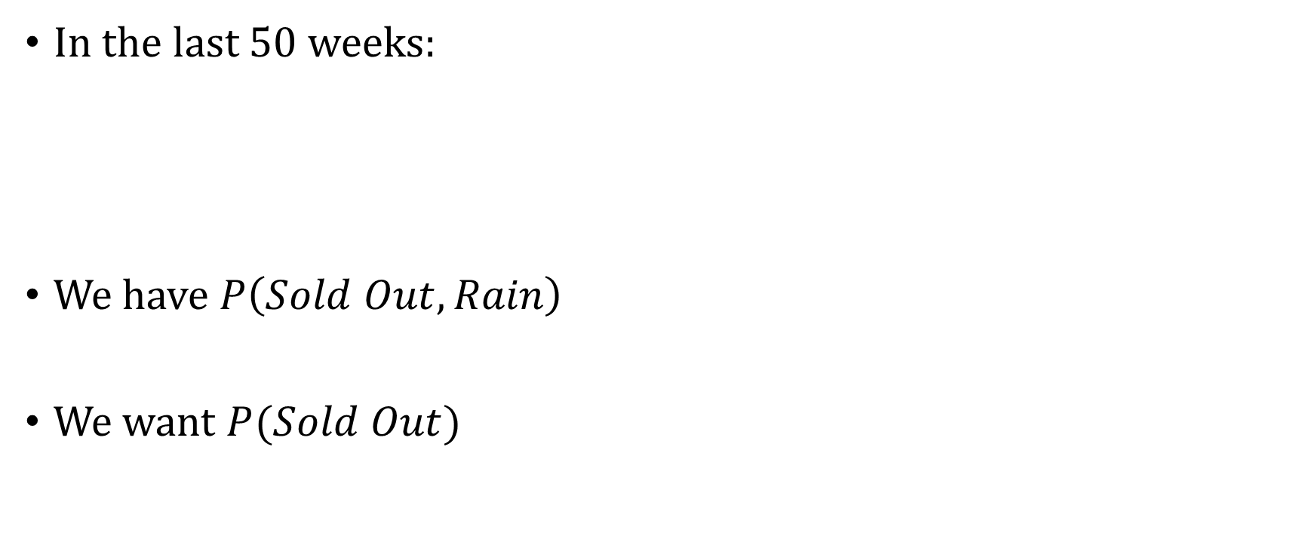
What Are We Doing When We Marginalize?
$$Sold Out$$ | $$Rain$$ | Count | $$P(Sold Out,$$ $$Rain)$$
0 (No) | 0 (No) | 10 | 10/50=.2
0 (No) | 1 (Yes) | 15 | 15/50=.3
1 (Yes) | 0 (No) | 5 | 5/50=.1
1 (Yes) | 1 (Yes) | 20 | 20/50=.4
In the last 50 weeks:
We have $P\left(Sold Out,Rain\right)$
We want $P(Sold Out)$

Slide 55
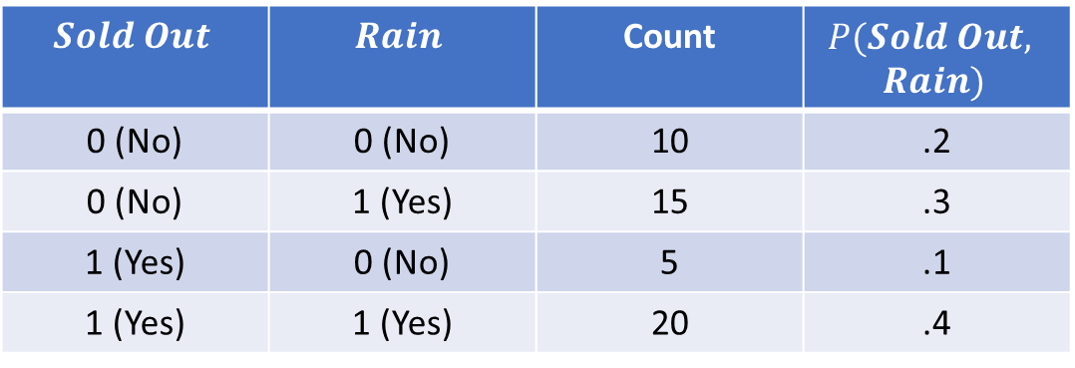
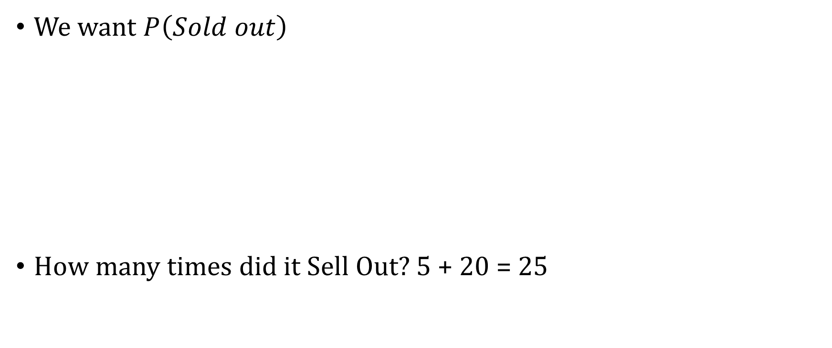
What Are We Doing When We Marginalize?
We want $P\left(Sold out\right)$
How many times did it Sell Out? 5 + 20 = 25
$$Sold Out$$ | $$Rain$$ | Count | $$P(Sold Out,$$ $$Rain)$$
0 (No) | 0 (No) | 10 | .2
0 (No) | 1 (Yes) | 15 | .3
1 (Yes) | 0 (No) | 5 | .1
1 (Yes) | 1 (Yes) | 20 | .4

Slide 56
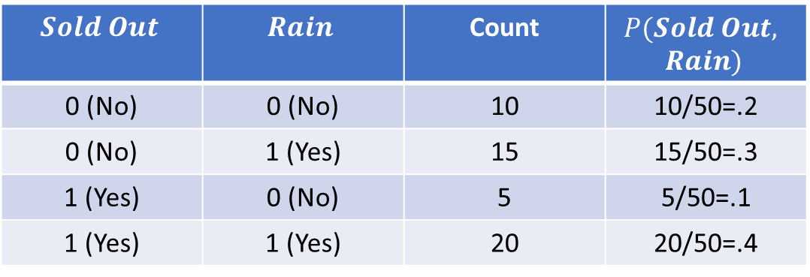
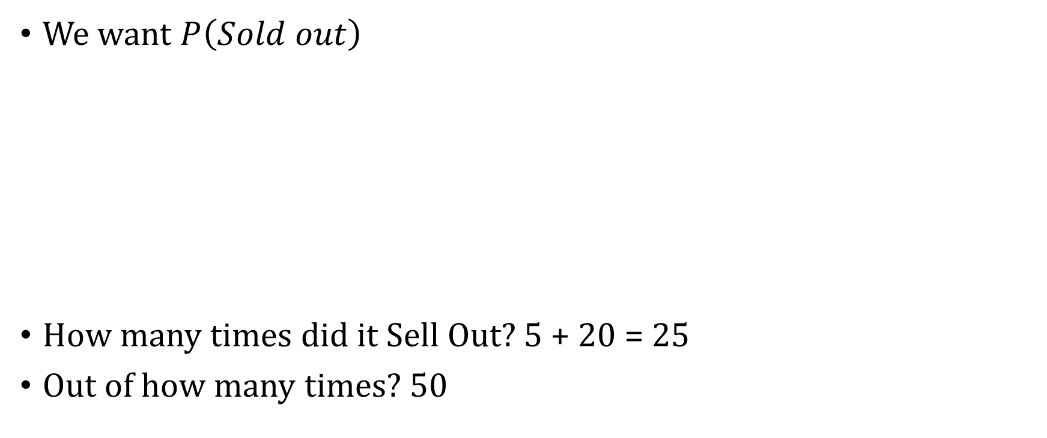
What Are We Doing When We Marginalize?
We want $P\left(Sold out\right)$
How many times did it Sell Out? 5 + 20 = 25
Out of how many times? 50
$$Sold Out$$ | $$Rain$$ | Count | $$P(Sold Out,$$ $$Rain)$$
0 (No) | 0 (No) | 10 | 10/50=.2
0 (No) | 1 (Yes) | 15 | 15/50=.3
1 (Yes) | 0 (No) | 5 | 5/50=.1
1 (Yes) | 1 (Yes) | 20 | 20/50=.4

Slide 57

What Are We Doing When We Marginalize?
We want $P\left(Sold out\right)$
How many times did it Sell Out? 5 + 20 = 25
Out of how many times? 50
P(Sold Out = 1) = $\frac{25}{50}=.5$
$$Sold Out$$ | $$Rain$$ | Count | $$P(Sold Out,$$ $$Rain)$$
0 (No) | 0 (No) | 10 | 10/50=.2
0 (No) | 1 (Yes) | 15 | 15/50=.3
1 (Yes) | 0 (No) | 5 | 5/50=.1
1 (Yes) | 1 (Yes) | 20 | 20/50=.4

Slide 58


Another Way of Writing It
$$Sold Out$$ | $$Rain$$ | Count | $$P(Sold Out,$$ $$Rain)$$
0 (No) | 0 (No) | 10 | 10/50=.2
0 (No) | 1 (Yes) | 15 | 15/50=.3
1 (Yes) | 0 (No) | 5 | 5/50=.1
1 (Yes) | 1 (Yes) | 20 | 20/50=.4
P(Sold Out = 1) = $\frac{25}{50}=\frac{5}{50}+\frac{20}{50}$

Slide 59

Another Way of Writing It
$$Sold Out$$ | $$Rain$$ | Count | $$P(Sold Out,$$ $$Rain)$$
0 (No) | 0 (No) | 10 | 10/50=.2
0 (No) | 1 (Yes) | 15 | 15/50=.3
1 (Yes) | 0 (No) | 5 | 5/50=.1
1 (Yes) | 1 (Yes) | 20 | 20/50=.4
P(Sold Out = 1) = $\frac{25}{50}=\frac{5}{50}+\frac{20}{50}$
P(Sold Out = 1) = $\frac{25}{50}=\frac{5}{50}+\frac{20}{50}=P\left(SO=1,R=0\right)+P(SO=1,R=1)$

Slide 60

Another Way of Writing It
$$Sold Out$$ | $$Rain$$ | Count | $$P(Sold Out,$$ $$Rain)$$
0 (No) | 0 (No) | 10 | 10/50=.2
0 (No) | 1 (Yes) | 15 | 15/50=.3
1 (Yes) | 0 (No) | 5 | 5/50=.1
1 (Yes) | 1 (Yes) | 20 | 20/50=.4
P(Sold Out = 1) = $\frac{25}{50}=\frac{5}{50}+\frac{20}{50}$
P(Sold Out = 1) = $\frac{25}{50}=\frac{5}{50}+\frac{20}{50}=P\left(SO=1,R=0\right)+P(SO=1,R=1)$
This is marginalizing

Slide 61
Probability Practice

Slide 62

The 2028 Election Cycle
Let $H$ = D if the Democrats win the House (R if Republicans win)
Let $S$ = D if the Democrats win the Senate (R if Republicans win)
We know
$P\left(House=Dem, Senate=Dem\right)=.4$
$P\left(House=Rep, Senate=Dem\right)=.1$
$P\left(House=Dem, Senate=Rep\right)=.2$

Slide 63
The 2028 Election Cycle
What is the probability that the Republicans win both the House and the Senate?

Slide 64


The 2028 Election Cycle
What is the probability that the Republicans win both the House and the Senate?
$P(House=Rep, Senate=Rep)$
$$H$$ | $$S$$ | $$P(H=h, S=s)$$
$$R$$ | $$R$$ | ?
$$R$$ | $$D$$ | 0.1
$$D$$ | $$R$$ | 0.2
$$D$$ | $$D$$ | 0.4

Slide 65


The 2028 Election Cycle
What is the probability that the Republicans win both the House and the Senate?
$P(House=Rep, Senate=Rep)$
What rule can we use?
$$H$$ | $$S$$ | $$P(H=h, S=s)$$
$$R$$ | $$R$$ | ?
$$R$$ | $$D$$ | 0.1
$$D$$ | $$R$$ | 0.2
$$D$$ | $$D$$ | 0.4

Slide 66


The 2028 Election Cycle
What is the probability that the Republicans win both the House and the Senate?
$P(House=Rep, Senate=Rep)$
Probabilities add up to one
$1−\left(.1+ .2+ .4\right)=1−0.7=0.3$
$$H$$ | $$S$$ | $$P(H=h, S=s)$$
$$R$$ | $$R$$ | 0.3
$$R$$ | $$D$$ | 0.1
$$D$$ | $$R$$ | 0.2
$$D$$ | $$D$$ | 0.4

Slide 67

The 2028 Election Cycle
What is the probability that the Democrats win the House?
$$H$$ | $$S$$ | $$P(H=h, S=s)$$
$$R$$ | $$R$$ | 0.3
$$R$$ | $$D$$ | 0.1
$$D$$ | $$R$$ | 0.2
$$D$$ | $$D$$ | 0.4

Slide 68

The 2028 Election Cycle
What is the probability that the Democrats win the House?
$P(H=D)$
What rule should we use?
$$H$$ | $$S$$ | $$P(H=h, S=s)$$
$$R$$ | $$R$$ | 0.3
$$R$$ | $$D$$ | 0.1
$$D$$ | $$R$$ | 0.2
$$D$$ | $$D$$ | 0.4

Slide 69

The 2028 Election Cycle
What is the probability that the Democrats win the House?
$P(H=D)$
What rule should we use?
$$H$$ | $$S$$ | $$P(H=h, S=s)$$
$$R$$ | $$R$$ | 0.3
$$R$$ | $$D$$ | 0.1
$$D$$ | $$R$$ | 0.2
$$D$$ | $$D$$ | 0.4

Slide 70

The 2028 Election Cycle
What is the probability that the Democrats win the House?
$P(H=D)$
What rule should we use?
$P\left(H=D\right)=P\left(H=D,S=R\right)+P\left(H=D,S=D\right)=.2+.4=.6$
$$H$$ | $$S$$ | $$P(H=h, S=s)$$
$$R$$ | $$R$$ | 0.3
$$R$$ | $$D$$ | 0.1
$$D$$ | $$R$$ | 0.2
$$D$$ | $$D$$ | 0.4

Slide 71
The 2028 Election Cycle
What is the probability that either the Democrats win the House or the Republicans win the Senate?
$$H$$ | $$S$$ | $$P(H=h, S=s)$$
$$R$$ | $$R$$ | 0.3
$$R$$ | $$D$$ | 0.1
$$D$$ | $$R$$ | 0.2
$$D$$ | $$D$$ | 0.4

Slide 72

The 2028 Election Cycle
What is the probability that either the Democrats win the House or the Republicans win the Senate?
What are the events that would satisfy this?
$$H$$ | $$S$$ | $$P(H=h, S=s)$$
$$R$$ | $$R$$ | 0.3
$$R$$ | $$D$$ | 0.1
$$D$$ | $$R$$ | 0.2
$$D$$ | $$D$$ | 0.4

Slide 73

The 2028 Election Cycle
What is the probability that either the Democrats win the House or the Republicans win the Senate?
What are the events that would satisfy this?
Let’s enumerate:
$H=R,S=R$
$H=R,S=D$
$H=D,S=R$
$H=D,S=D$

Slide 74

The 2028 Election Cycle
What is the probability that either the Democrats win the House or the Republicans win the Senate?
What are the events that would satisfy this?
Let’s enumerate:
$H=R,S=R, Yes$
$H=R,S=D, No$
$H=D,S=R, Yes$
$H=D,S=D, Yes$

Slide 75

The 2028 Election Cycle
What is the probability that either the Democrats win the House or the Republicans win the Senate?
What are the events that would satisfy this?
Let’s enumerate:
$H=R,S=R, Yes$
$H=R,S=D, No$
$H=D,S=R, Yes$
$H=D,S=D, Yes$
$$H$$ | $$S$$ | $$P(H=h, S=s)$$
$$R$$ | $$R$$ | 0.3
$$R$$ | $$D$$ | 0.1
$$D$$ | $$R$$ | 0.2
$$D$$ | $$D$$ | 0.4

Slide 76

The 2028 Election Cycle
What is the probability that either the Democrats win the House or the Republicans win the Senate?
What are the events that would satisfy this?
Let’s enumerate:
$H=R,S=R, Yes$
$H=R,S=D, No$
$H=D,S=R, Yes$
$H=D,S=D, Yes$
$P\left(X\right)=P\left(H=R,S=R\right)+P\left(H=D,S=R\right)+P\left(H=D,S=D\right)= .3+ .2+ .4=.9$
$$H$$ | $$S$$ | $$P(H=h, S=s)$$
$$R$$ | $$R$$ | 0.3
$$R$$ | $$D$$ | 0.1
$$D$$ | $$R$$ | 0.2
$$D$$ | $$D$$ | 0.4

